Slide 1

Federated Learning:
A New Era of Decentralized AI
Revolutionizing Privacy-Preserving Machine Learning
Presented By Gurram Shravani
Hall Ticket No: 2203A52024
Course: Technical Seminar
Guided By: Dr. P. Chandra Shekar Reddy
Professor of CSE
SR University, Warangal, Ts, India.

Slide 2
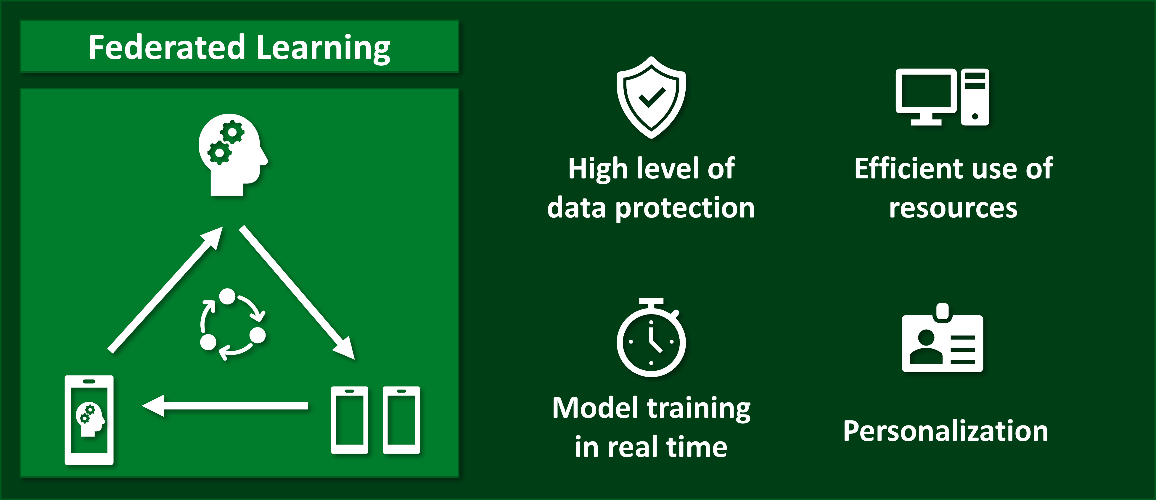
Introduction to Federated Learning
What is Federated Learning?
Federated Learning is a decentralized machine learning method where devices train models locally and share only model updates. It ensures data privacy by keeping sensitive data on the device.
FL protects data privacy and security, avoids the need for centralizing sensitive data, and enables AI across diverse data sources without data transfer.

Slide 3
Why Federated Learning Important?
1
A Decentralized Approach
2
Preserving Data Privacy
3
Scalable and Efficient
By keeping data local and only sharing model updates, Federated Learning significantly enhances data privacy and security. Users maintain control over their personal information, addressing the growing concerns around data ownership and consent.
Federated Learning leverages the vast computing resources of millions of edge devices, such as smartphones and IoT sensors, to train AI models in a distributed and scalable manner. This approach overcomes the limitations of centralized data centers and enables AI to be deployed at unprecedented scale.
Federated Learning is a revolutionary approach that enables AI models to be trained on distributed data sources, without the need to centralize the data. Instead, the model is trained on the user's device, and only the model updates are shared with a central server.

Slide 4
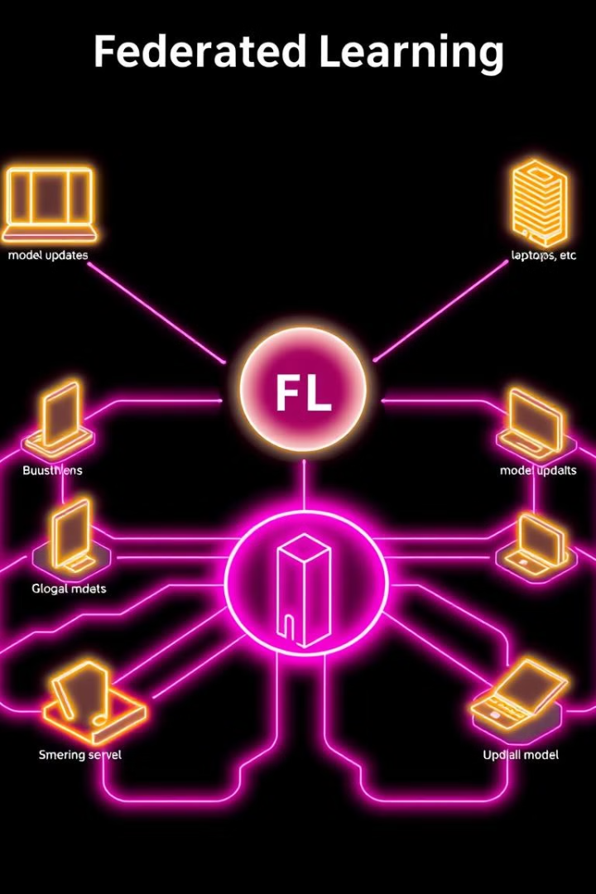
How Federated Learning Works
1
Local Training
Each participating device trains the AI model on its local data, without sharing the raw data with a central server.
2
Model Aggregation
The model updates from the devices are sent to a central server, where they are aggregated to create a global model update.
3
Global Model Update
The updated global model is then shared back to the participating devices, where it is used to update the local model for the next round of training.

Slide 5
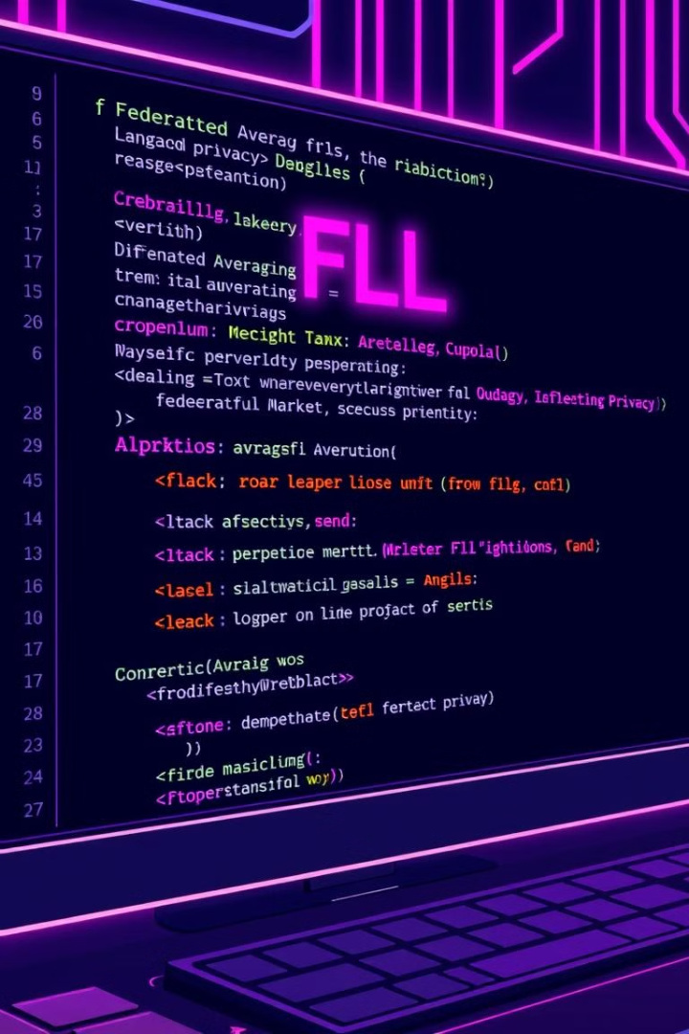
Key Technologies Behind Federated Learning
Federated Averaging Algorithm
Tools and Frameworks
TensorFlow Federated (by google )and PySyft are widely used frameworks that provide tools and libraries for implementing FL.
An efficient technique for combining model updates from multiple devices, ensuring a robust global model.
Security Techniques
Differential privacy and secure multiparty computation protect sensitive data by masking individual contributions and encrypting computations, respectively.

Slide 6




Technical Advancements in Federated Learning
Secure Aggregation
Differential Privacy
Model Compression
Techniques like secure multi-party computation enable the central server to aggregate model updates without accessing the raw data, further enhancing privacy.
Differential privacy algorithms can be applied to the Federated Learning process to provide mathematical guarantees about the privacy of the individual data contributions.
Innovative model compression techniques reduce the size of the model updates, minimizing the communication overhead and enabling faster convergence.

Slide 7




Applications of Federated Learning
Healthcare
FL enables training models on sensitive patient data without sharing raw data, improving medical imaging and diagnostics.
IoT
Smart devices can learn user preferences and improve performance without relying on centralized data storage.
Finance
FL facilitates fraud detection using decentralized transaction data, enhancing security and efficiency in financial systems.

Slide 8

Advantages of Federated Learning
Enhanced Data Privacy
Improved Scalability
Federated Learning ensures that sensitive user data never leaves the device, addressing privacy concerns and complying with regulatory requirements.
By leveraging millions of edge devices, Federated Learning can scale AI training to unprecedented levels, overcoming the limitations of centralized data centers.
Increased Efficiency
Personalized Models
Federated Learning reduces the computational and communication overhead, as only model updates are shared, rather than raw data.
Federated Learning can create personalized AI models by adapting to the unique data and patterns of each user, leading to more accurate and relevant predictions.

Slide 9





The Future Outlook for Federated Learning
Widespread Adoption
1
As the benefits of Federated Learning become more widely recognized, we can expect to see its adoption across a diverse range of industries and applications.
Advancements in Privacy and Security
2
Continued research and development in areas like secure aggregation and differential privacy will further strengthen the privacy and security guarantees of Federated Learning.
Personalization and Customization
3
The ability to create personalized AI models tailored to individual users will unlock new opportunities for hyper-personalized services and solutions.
Edge Computing and IoT Integration
4
The integration of Federated Learning with edge computing and the growing Internet of Things ecosystem will enable the deployment of AI at unprecedented scale and in diverse real-world settings.
Ethical and Responsible AI
5
Federated Learning's focus on privacy and data sovereignty will play a crucial role in the development of ethical and responsible AI systems that prioritize user trust and control.

Slide 10



Real-World Case Studies
Google Gboard
Healthcare Collaboration
IoT and Autonomous Vehicles
Uses FL to personalize predictive text without uploading user data, improving user experience.
Hospitals train shared models for cancer detection while preserving privacy, improving accuracy and efficiency.
FL enhances smart systems for navigation and efficiency, improving safety and performance.

Slide 11



Future of Federated Learning
Advanced Privacy Techniques
1
Homomorphic encryption and secure protocols are being developed to further enhance privacy.
New Applications
2
FL has potential applications in autonomous systems, robotics, and edge AI.
Overcoming Challenges
3
Scalable communication and efficient algorithms are being researched to address current limitations.

Slide 12

Conclusion
Federated learning is a transformative approach for privacy-preserving AI, enabling secure and decentralized model training across various domains. Its future holds immense potential for shaping the future of AI, making it more accessible, ethical, and secure.
The future of AI is decentralized.

Slide 13
THANK YOU

